Slide 1

CYBV 480 Cyber Warfare
Week 3
Reconnaissance

Slide 2
Agenda
Pentesting Stages
What is Reconnaissance?
Online Anonymity & Attribution
Documenting Reconnaissance Findings
Whois Searches
People Searches
Credentials Searches
Social Media Searches
Social Media Monitoring
Job Postings Searches
Automated Reconnaissance Tools
Metadata & Metadata Search Tools
Search Engine Searches & Search Diggity Tools
Google Cache & Wayback
DNS Lookups
Recon-ng / Discover

Slide 3
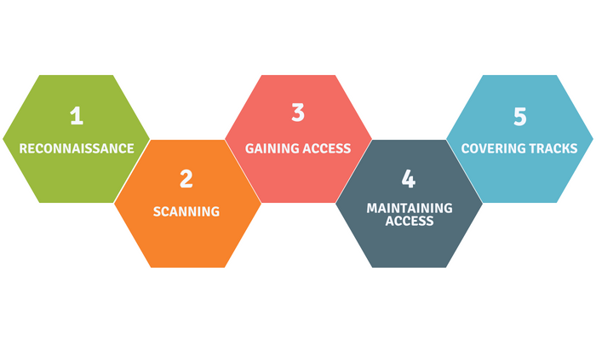
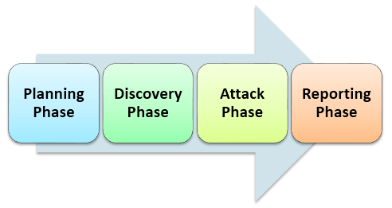
Pentesting Stages

Slide 4
Cyber Reconnaissance
Phase that gathers information from public sources to learn about the target
Selection and Discovery
Who / What is going to be targeted?
Organization, Personnel, Individuals, Cause / Campaigns / Groups
Data Sources
Resource Extraction and Mining
What can I find out about the target?
Personal Data, Geographic Data, Historical Data, Contacts, Achievements, Online Persona Data, Social Media Data, Credentials, Personality Data, Defensive Posture
Resource Correlation and Information Processing
What does all the data mean?
Links, patterns, relationships, likes, dislikes
Anything that can be leveraged to assist in an attack
Attack Modeling
How can the collected and processed data be used to conduct a successful attack?
Identify and define the attack vectors with the greatest possible chances of success.

Slide 5
Anonymity & Attribution
Cyber reconnaissance can make or break an operation
De-anonymization is a serious business
Cyber actors are looking for you too!
People are creatures of habit
We fail to follow security protocols
We are all lazy at one point or another
Links and Patterns
Times, Dates, Frequency
Action patterns
Patterns of life
“Ripples in a Pond”
Everyone makes them no matter how careful they are in their actions
The absence of ripples is more telling than the ripples themselves
Linking the absence of ripples to an alternate set of ripples is the solution!

Slide 6


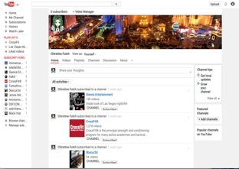
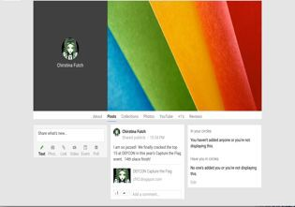
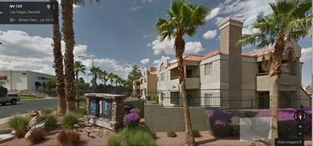


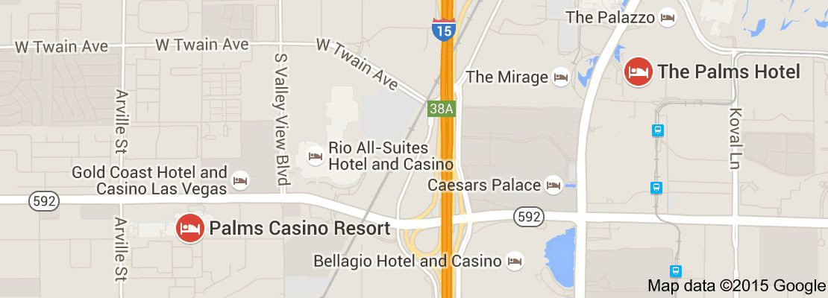

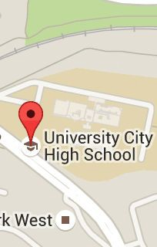

Sock Puppets
Online Fake Persona
Persona Depth and Breadth is Important
Prepaid Credit Cards
Prepaid Phones
Home Addresses
Know your local news and weather
Lifetime of details
Biographical Data
Likes & Dislikes
Schools, Teachers, & Staff
Friends, Co-Workers and Associates
Parents and Grandparents
Children
Create Overt Footprints
Be found online (listyourself.net)
Phone numbers & email addresses
Social media Accounts
Create Associations

Slide 7
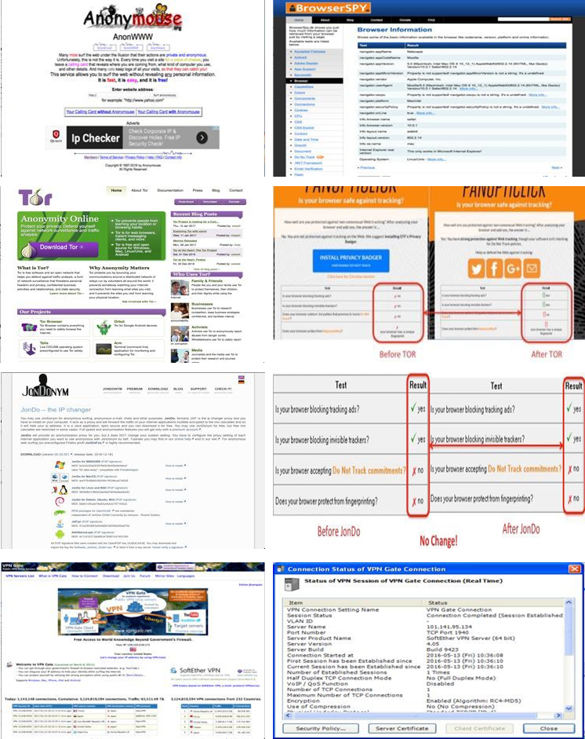
Anonymization is Hard
Anonymizing Techniques
Anonymizing Services – Insecure
TOR – Insecure
IP Changing Services – Insecure
Proxy Servers – Insecure
Additional Steps are Required
Use multiple methods
Change MAC address
Route through Public WiFi
Hop with Wireless Access Points (WAP)
WiFi bridging
Use prepaid cell phone modems
Use phone number masking
Email header masking
Web-based proxy services (recon, scanning, etc)
Pivoting
The Art of Invisibility / Ghost in the Wires

Slide 8
Document Findings
Everything should be documented
You never know when a piece of information will become useful
Minimum target data
Names
IP Addresses
Operating system and applications with version data
Listening ports
Known vulnerabilities
Admin accounts and credentials
User and miscellaneous accounts and credentials
Usernames, cracked passwords and hashes
Pillaged data (Security tokens, encryption keys)
Target and associations (Businesses, coworkers, friends)
Personal data (web scraping, people searches, credential searches)
How things were discovered (Scan, web search, zone transfer, metadata, social engineering, told during scoping)

Slide 9
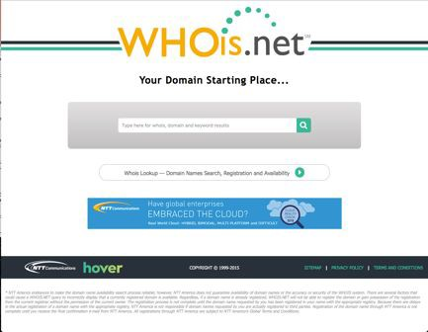
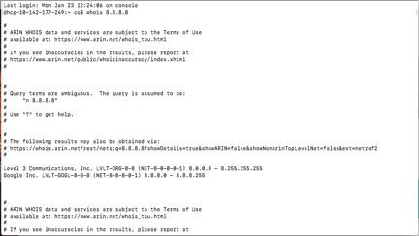
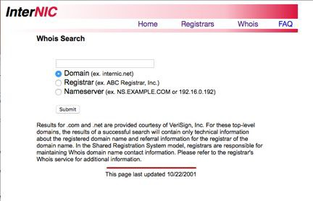
Whois Searches
Query various registrars to determine information about the target’s internet gateway
Web-based whois sites
Command line tools ($ whois 8.8.8.8)
Don’t blindly trust the results
Start with InterNIC
Explore individual registrars for more details
CIDR block size – target network size
Autonomous System (AS) number assignments – internal routing details
Registrant as well as administrative and technical points of contact
Name servers and IP addresses

Slide 10
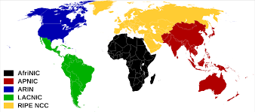
Whois Searches
IP Address Assignment Whois Databases
American Registry for Internet Numbers (ARIN)
Reseaux IP Europeans Network Coordination Center (RIPE NCC)
Asia Pacific Network Information Center (APNIC)
Latin American and Caribbean Internet Address Registry (LACNIC)
AfriNIC

Slide 11
DNS Lookups
DNS Record Types
NS: Nameserver record
A: Address record for IPv4 addresses for a given hostname
AAAA: “Quad-A” record for IPv6 address for a given hostname
HINFO: Host Information Record
MX: Mail Exchange record
TXT: Text record
CNAME: Canonical Name record (Aliases)
SOA: Start of Authority record
RP: Responsible Person record
PTR: Pointer for inverse lookups record
SRV: Service location record
SPF: Sender Policy Framework

Slide 12
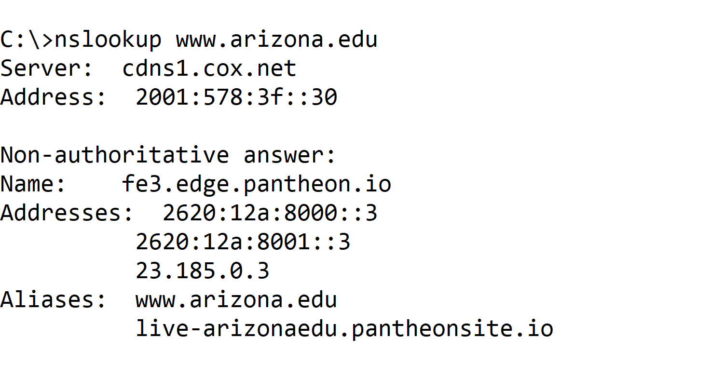
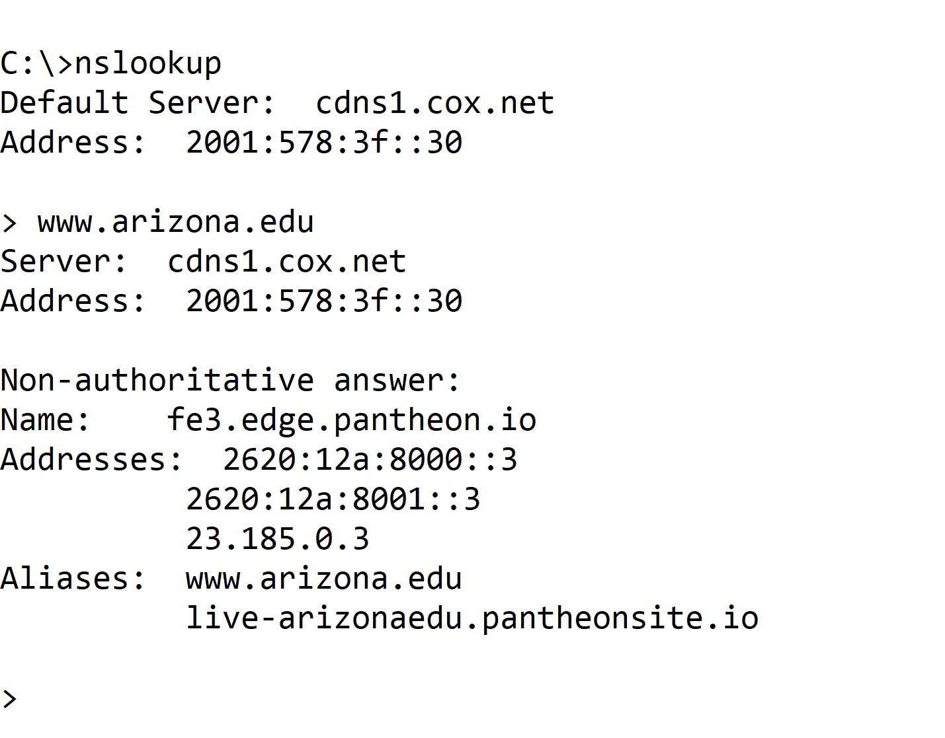
nslookup Command
Included in modern Windows, Linux and Unix
nslookup
nslookup followed by domain name
nslookup – enter interactive mode
nslookup
nslookup interactive

Slide 13
nslookup Interactively
Resolve an individual name or IP address
[name or IP address]
Use a different DNS server
server [serverIPaddress or name]
Set the type of record
set type=MX for Mail Exchange record
set type=any for all record types
Perform a zone transfer of all records for a given domain
ls –d [target_domain]
Store zone transfer output in a file
ls –d [target_domain] [> filename]
View file
view [filename]

Slide 14
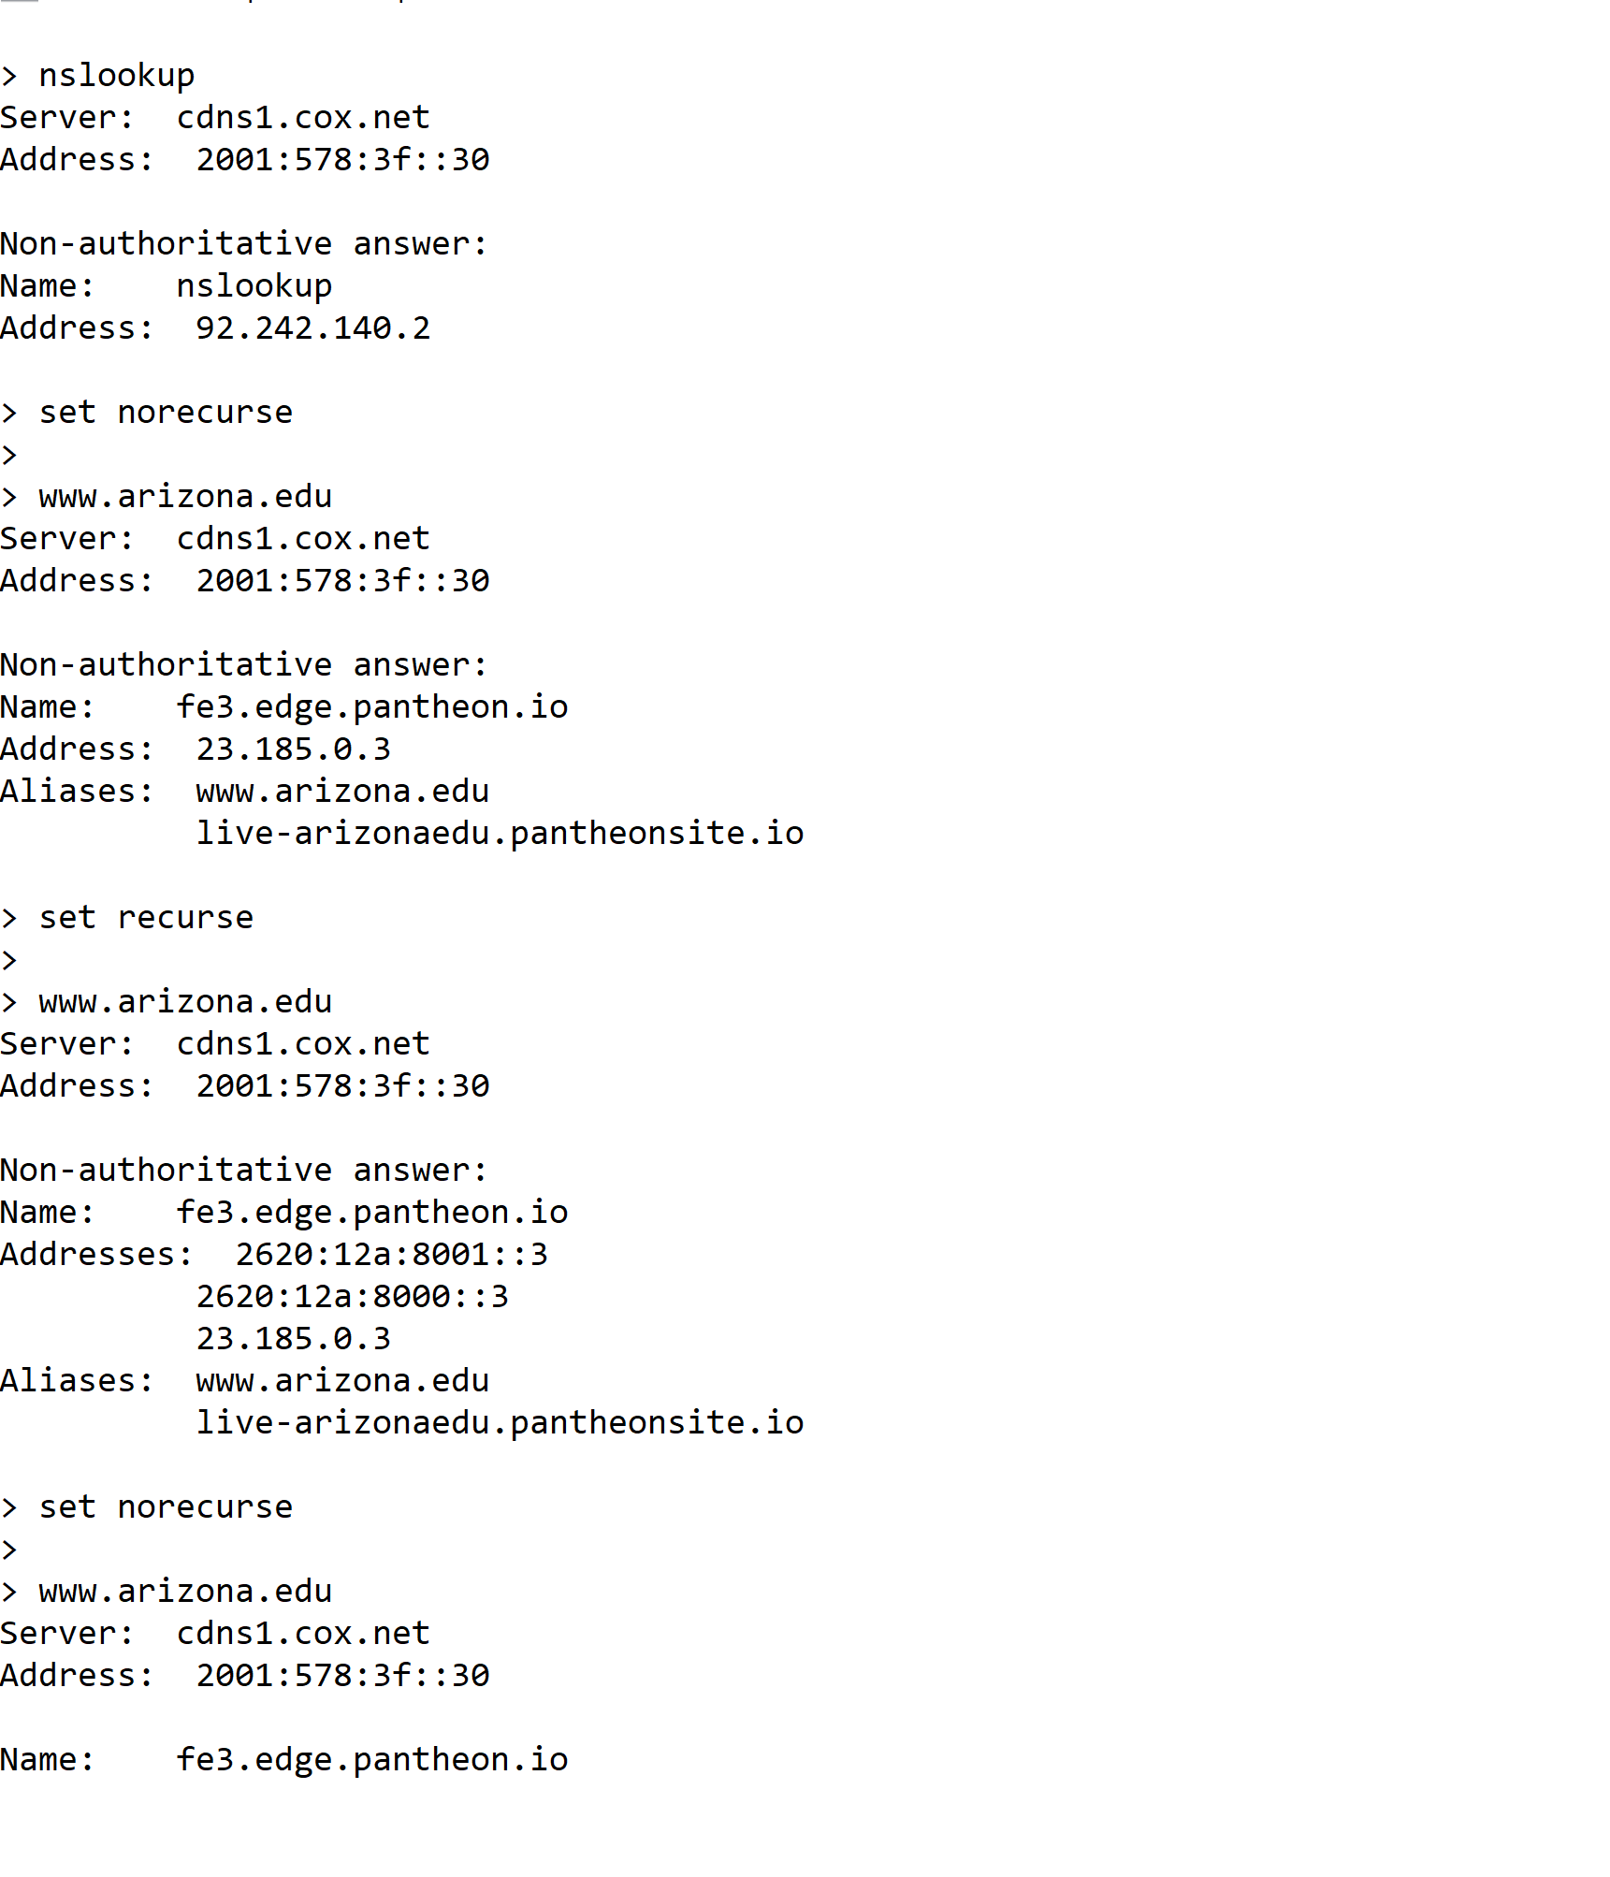
nslookup Recurse / Norecurse

Slide 15
dig Command
nslookup command in modern Linux doesn’t perform a zone transfer
dig command in most Linux / UNIX versions can
$ dig @[server] [name] [type]
Type can be:
ANY
A (Default)
MX
Zone transfer
Full zone transfer: -t AXFR
Incremental zone transfer: -t IXFR=N
Provides records changed since SOA serial number was N

Slide 16
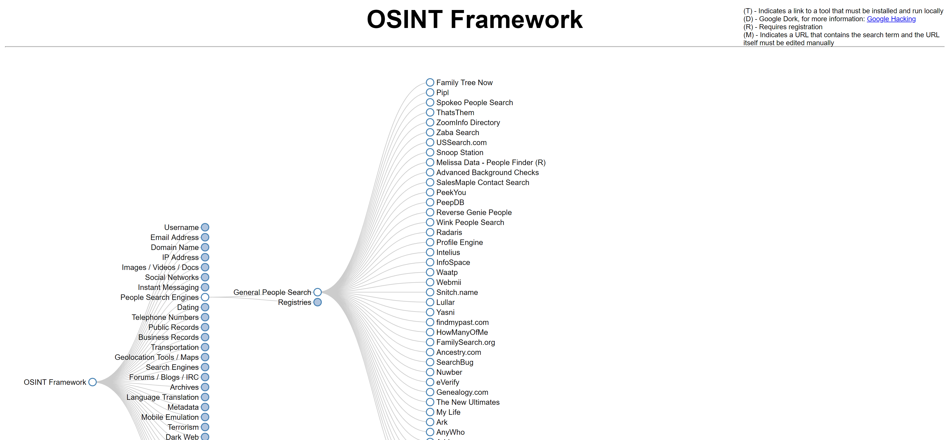
OSINT Framework

Slide 17
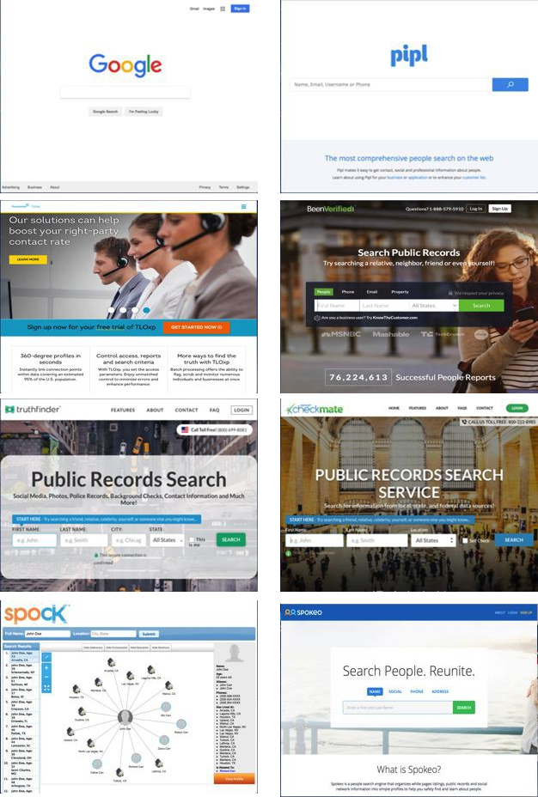
People Searches
What can I do?
Locate personal, geographic, and patterns of life data
Identify contacts, relationships, likes, dislikes, keywords, historical data, achievements, online persona data, social media data, personality data
Begin to assess defensive posture
Where do I look?
Google
Pipl.com (no longer free)
TransUnion TLOxp (tlo.com)
Been Verified (beenverified.com)
Truthfinder (truthfinder.com)
Checkmate (instantcheckmate.com)
US Search (ussearch.com)
Spokeo (spokeo.com)

Slide 18
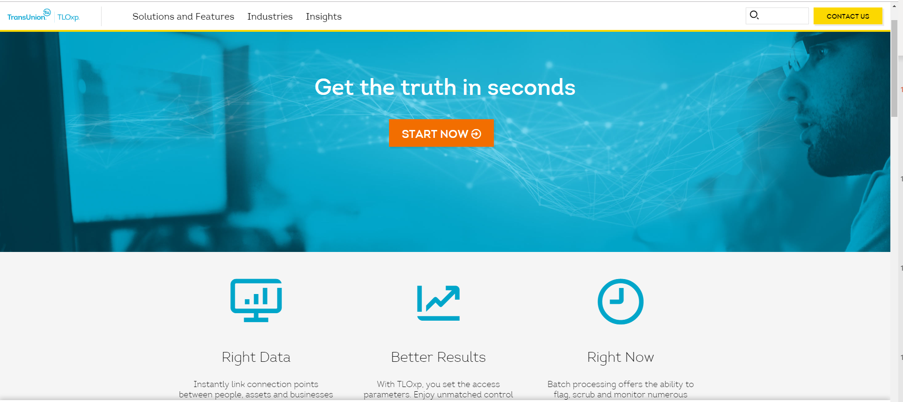

TLO
People and Asset Searches
360 profile – Obtain information from basic information like names, phones, emails and addresses to detailed data on employment, aliases, assets, criminal history, bankruptcies and more
Vehicles – Vehicle searches return information from even partial vehicle descriptions and VIN numbers. Now fused with License Plate Recognition Data, you can instantly view recent and historical license plate sighting data
Partial data searches – Enter partial information from addresses, SSNs, telephone numbers and more. Search by location, radius, or age range. Even enter a phonetic name spelling, and TLOxp narrows the search to the fewest possible options.

Slide 19
TLO
Business Searches
Complete corporate profiles – Past and present legal and fraud issues, current and former corporate officers, liquidations, assets and much more
Global reach – Domestic and international business coverage, and we’re adding more data points on activity overseas every day. Protect your business with information on companies and individuals contained on U.S sanctions and watch lists.

Slide 20
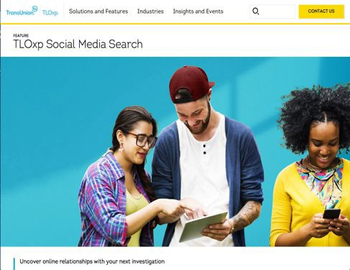
TLO – Social Media
Social Media Searches
Social Media Search provides information from over 140 social media sources. Potentially verify identify and gain insight on associations and relationships through data that helps create a more complete view of a subject
Search results may include:
Name, age, and gender
Potential online profiles for a subject that link directly to external social websites
Profile photographs

Slide 21

TLO – Employment
Place of Employment searches
TLOxp provides data on more than 95% of the U.S. population and has more than 225 million employment records and growing, making it one of the largest sources of employment data in America. By quickly accessing actionable employment data, you can locate consumers efficiently, better prioritize inventory and investigate fraud more thoroughly to mitigate risk.
Identify target leverage points
Employer and HR personnel
Fellow employees
Work related patterns of life
Work related credentials
Social Engineering Jackpot!

Slide 22
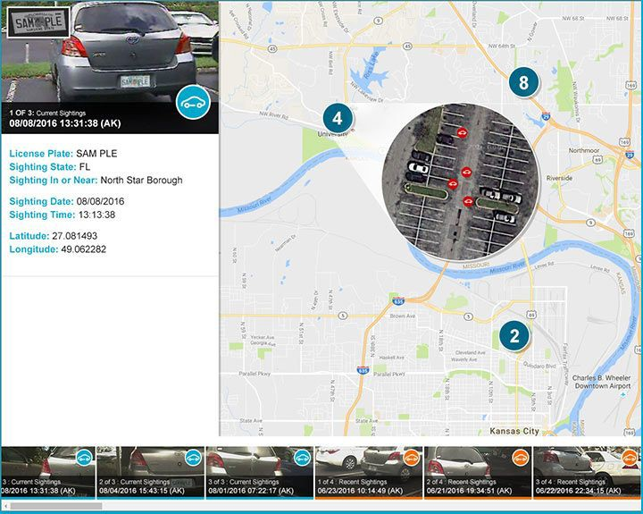
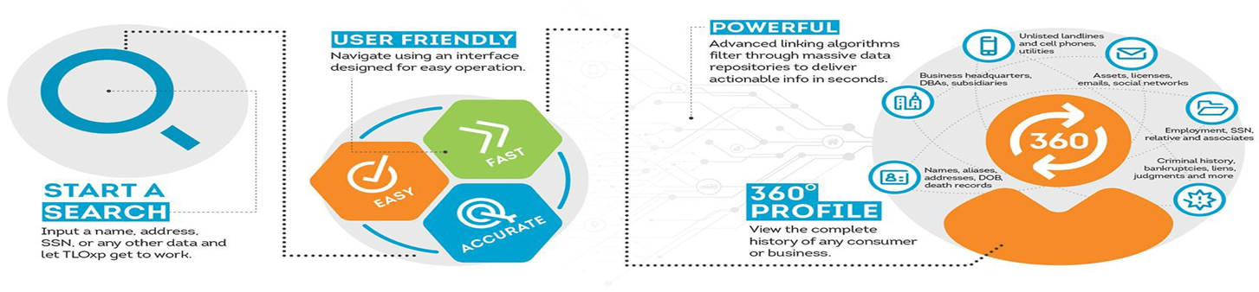
TLO – Vehicle Sightings
Use Vehicle Sightings to:
Spot patterns by plotting multiple sightings for the same vehicle
Uncover the most likely locations of search objects
Reveal predictive travel patterns
Identify potential associates / relationships / contacts
Reach subjects who are actively avoiding contact
Identify and track patterns of life

Slide 23
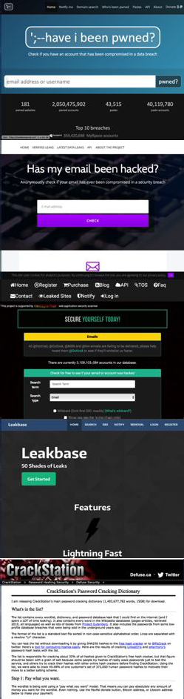
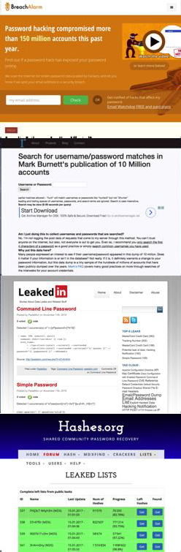
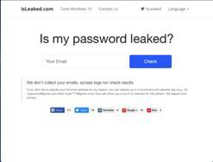
Credentials Search
What can I do?
Locate possible data leaks
Identify sites that have known breaches
Identify emails, usernames and names that are associated with published credentials lists
Where do I look?
Have I been Pwned (haveibeenpwned.com)
CrackStation (crackstation.net)
Data Breach Check (whatismyipaddress.com/breach-check)
Alternative To (https://alternativeto.net/software/leakbase/)

Slide 24
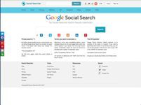


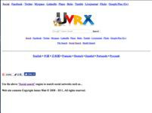

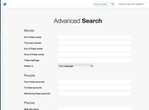
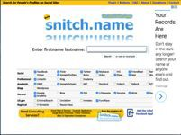
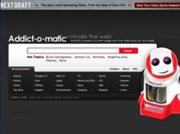
Social Media Search
What can I do?
Mine profiles for data
Conduct link and pattern analysis
Identify secondary targets or pivot points
Identify social engineering attack vectors
Where do I look?
Google Social Search (social-searcher.com)
Facebook Search (search.fb.com)
Twitter Advanced Search (twitter.com/search-advanced)
Flickr Advanced Search (flickr.com/search/advanced)
Snitch.name (snitch.name)
Addict-o-matic (crunchbase.com)
UVRX (uvrx.com)
Talkwalker (talkwalker.com)

Slide 25
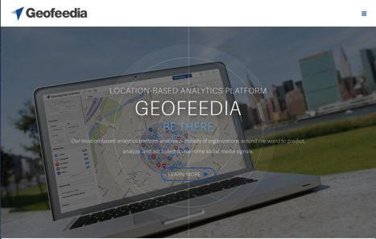
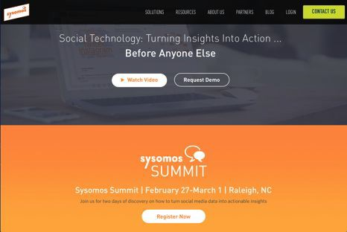
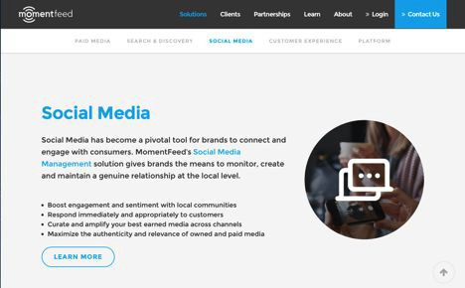
Social Media Monitoring
Automatically extract data from webpages
Geo-locate / track Social Media Users
Monitor Users Movements
Monitor Online Conversations
Identify and Track Trends
Serve Users Targeted Ads
Social Engineering / Client-Side Attacks
Data Conversion
Duplication Removal
Statistical Analysis
Clustering
Trends
Linkages
Password List Inclusion
Web Scraping
Sysomos (https://meltwater.com/en/sysomos-meltwater.com)
Momentfeed (https://momentfeed.com)

Slide 26
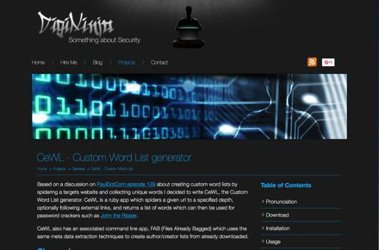
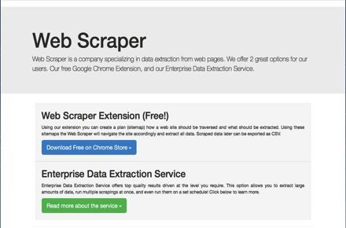
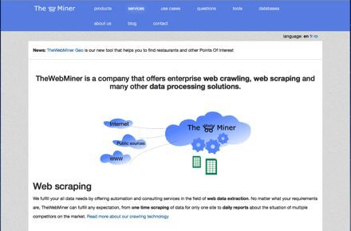
Web Scraping
Automatically extract data from webpages
Text
Pictures
Videos
Metadata
Links
Attributes
Data Processing
Data Conversion
Duplication Removal
Statistical Analysis
Clustering
Trends
Linkages
Password List Inclusion

Slide 27
Web Scraping
Web Scraping
Cewl (https://digi.ninja/projects/cewl.php)
Web Scraper (http://webscraper.io)
The WebMiner (https://thewebminer.com/services)

Slide 28

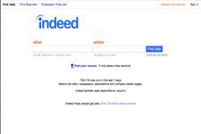
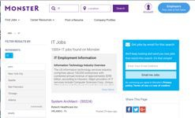
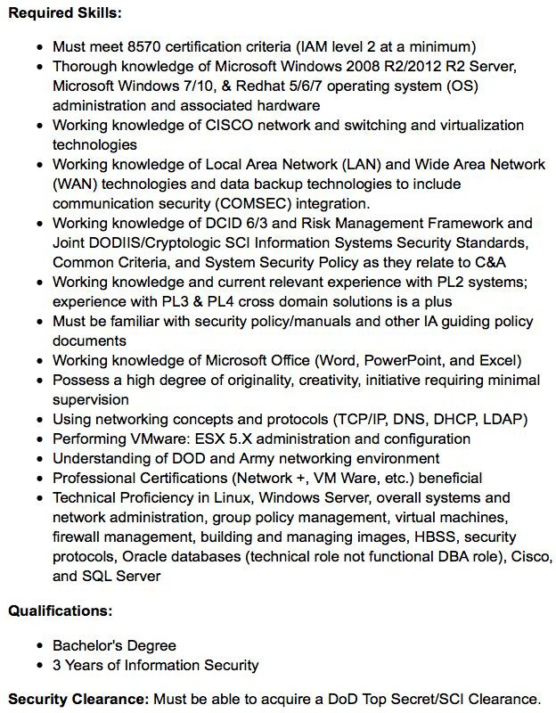
Job Postings
What can I do?
Find job openings and how long vacant
Find target resumes
Identify IT baselines
Identify software in use
Identify HR personnel
Develop Social Engineering Attack Vectors
Where can I look?
Company Websites
Indeed (indeed.com)
Monster (monster.com)
The Ladders (theladders.com)
Up Work (upwork.com)
Career Builder (careerbuilder.com)

Slide 29
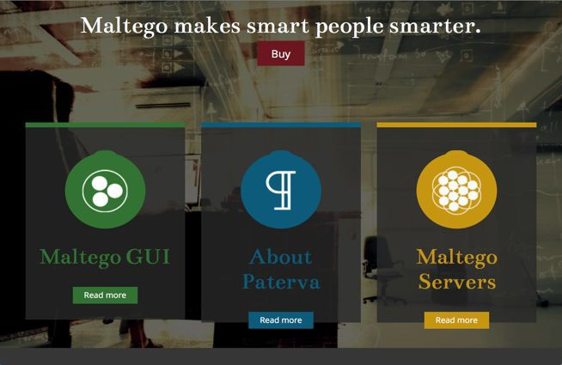
Automated Tools
Maltego
(https://www.paterva.com/web7/buy/maltego-clients/maltego-ce.php)
Maltego is an interactive data mining tool that renders directed graphs for link analysis. The tool is used in online investigations for finding relationships between pieces of information from various sources located on the Internet.
Some consider Maltego an open source intelligence (OSINT) and forensics application. It will offer you an interface for mining and gathering of information as well as the representation of this information in an easy to understand format. Coupled with its graphing libraries, Maltego allows you to identify key relationships between information and identify previously unknown relationships between them.

Slide 30
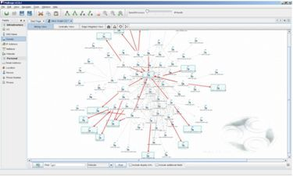
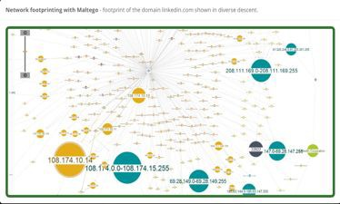
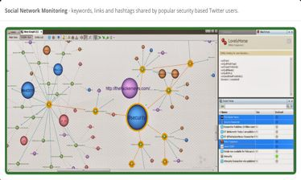
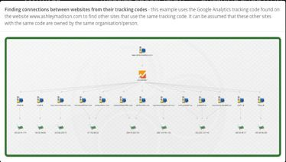
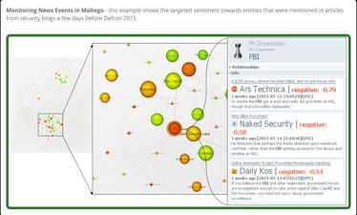
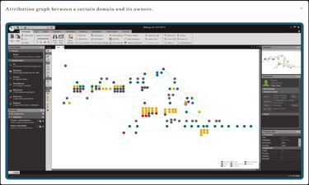
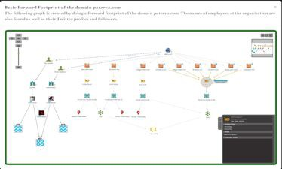
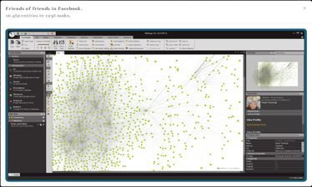
Maltego
What can you do with Maltego?
Social Linkages
Network Footprinting
Social Media Monitoring
New Event Monitoring
Website Linkages
Attribution Graphs
Web Domain Linkages

Slide 31
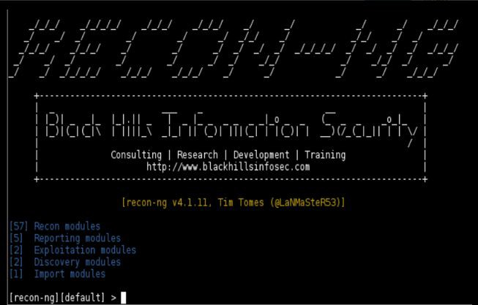
Automated Tools
Recon-ng
https://bitbucket.org/LaNMaSteR53/recon-ng
Recon-ng is a full-featured Web Reconnaissance framework written in Python. Complete with independent modules, database interaction, built in convenience functions, interactive help, and command completion, Recon-ng provides a powerful environment in which open source web-based reconnaissance can be conducted quickly and thoroughly.

Slide 32

Metadata
Most file contain a significant amount of Metadata
Data that describes other data
Associated with the document’s formatting and display characteristics
More useful metadata can be present
Examples of valuable Metadata
Usernames
File system paths
Email addresses
Software used to create the file (including version numbers)
Creation dates, modification dates, programs used to modify the file, etc.
Hidden or obscured fields
Etc.

Slide 33












Metadata – File Types
Documents have a wealth of metadata in them
Files containing Metadata can be used to gain important data on targets such as:
Usernames
Email Addresses
System Information
File Types
PDF
Word Documents
PowerPoint
Excel
HTML
MP4
MP3

Slide 34
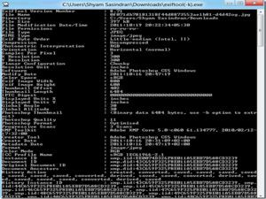
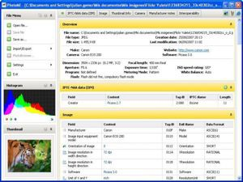


Metadata – Tools
Manual Examination
EXIFTool (http://www.sno.phy.queensu.ca/~phil/exiftool/)
Structured Data
PhotoMe (https://www.photome.de)
Strings command
Included with most Linux / Unix
Available as separate download for Windows
Unstructured Data
Automated Tools
FOCA (https://github.com/ElevenPaths/FOCA)
Hacker Factor (hackerfactor.com)
TinEye (tineye.com)

Slide 35

Metadata – EXIFTool
Extract information from a file
exiftool a.jpg
A basic command to extract all metadata from a file name a.jpg
Basic write example
exiftool –artist=me a.jpg
Writes artist tag to a .jpg. Since no group is specified, EXIF:Artist will be written, and all other existing Artist tags will be updated with the new value (“me”)
Write multiple files
exiftool –artist=me a.jpg b.jpg c.jpg
Writes Artist tags to three image files
Write to all files in a directory
exiftool –artist=me c:/images
Writes Artist tag to all files in directory c:/images
Write multiple tags
exiftool –artist=“Phil Harvey” –copyright=“2011 Phil Harvey” a.jpg
Writes two tags to a.jpg

Slide 36

FOCA
What is FOCA?
FOCA (Fingerprinting Organizations with Collected Archives) is a tool used mainly to find metadata and hidden information in the documents it scans.
These documents may be on web pages and can be downloaded and analyzed with FOCA.
What can FOCA do?
Web Search
Searches for hosts and domain names through URLs associated to the domain
Each link is analyzed to extract from its new host and domain names
DNS Search
Each domain is checked to ascertain which are the host names configured in NS, MX, and SPF servers to discovery new host and domain names.
IP Resolution
Each host name is resolved by comparison to DNS to obtain the IP address associated to this server name.
To perform this task as accurately as possible, the analysis is carried out against a DNS that is internal to the organization

Slide 37
FOCA
What can FOCA do continued?
PTR Scanning
To find more servers in the same segment of a determined address, IP FOCA executes PTR log scans
Bing IP
For each IP address discovered, a search process is launched for new domain names associated to that IP address
Common Names
This module is designed to carry out dictionary attacks against DNS. It uses a text file containing a list of common host names such as ftp, pc01, pc02, intranet, extranet, internal, test, etc.
DNS Prediction
Used for those environments where a machine name has been discovered that is reason to suspect that a pattern is used in the name system
Robtex
The Robtex service is one of many services available on the Internet to analyze IP addresses and domain names. FOCA uses it in its attempt to discover new domains by searching the information available in Robtext on the latter.

Slide 38
Google Searches
ext: | site:sans.org ext:ppt Will search for files with ppt suffixes only on sans.org only
filetype: | site:sans.org filetype:ppt Will search for ppt files only on sans.org only
intitle: | intitle: index.of passwd Finds indexed web directories with the word passwd in the directory listing e.g. /etc/passwd /etc/shadow file
inurl: | inurl:viewtopic.php Finds a script included in phpBB
Job Openings | site:[companydomain] careers, site:[companydomain] jobs, site:[companydomin] openings
link: | link: www.sans.org Shows all sites linked to a given site
Nessus scan results | intitle: "Nessus Scan Report" "This file was generated by Nessus"
PGP/GnuPG private key rings | intitle:index.of intext: "secring.skr" | "secring.pgp" | "secring.bak"
related: | related: namp.org Shows similar pages
Robot.txt files with excessive disallow lines | robots.txt disallow filetype:txt
Shell history | site:somethinginteresting intitle:index.of bash_history
site: | site:[companydomian] [keyword] e.g. site:www.acme.com careers Searches only within a given domain

Slide 39


Google Hacking Database
Google Hacking Database (GHDB)
https://www.exploit-db.com/google-hacking-database/
GHDB is an authoritative source for querying the ever-widening reach of the Google search engine. In the GHDB, you will find search terms for files containing usernames, vulnerable servers, and even files containing passwords

Slide 40





Search Diggity
Search Diggity
SearchDiggity is the primary attack tool of the Google Hacking Diggity Project. It is Bishop Fox’s MS Windows GUI application that servers as a front-end to the most recent versions of our Diggity tools: GoogleDiggity, BingDiggity, BingLinkFromDomainDiggity, CodeSearchDiggity, DLPDiggity, FlashDiggity, MalwareDiggity, PortScanDiggity, SHODANDiggity, BingBinaryMalwareSearch and NotInMyBackYardDiggity.
https://resources.bishopfox.com/resources/tools/google-hacking-diggity/google-hacking-history/

Slide 41

Google Cache & Wayback
WayBack Machine
https://archive.org/web
Wayback Machine is based on an index built by evaluating terms from hundreds of billions of links to the homepages of more than 350 million sites. Search results are ranked by the number of captures in the Wayback and the number of relevant links to the site’s homepage
Cached View
http://cachedview.com
Source for compiled Internet caching services
Google Cache
Google takes a snapshot of each it examines and caches (stores) that version as a back-up. The cached version is what Google uses to judge if a page is a good match for your query.
Cache: search operator
cache: www.pandemonia.com/flying/

Slide 42

Discover Scripts
Custom bash scripts used to automate various penetration testing task including recon, scanning, parsing, and creating malicious payloads and listeners with Metasploit.
Written by Lee Baird
https://github.com/leebaird/discover

Slide 43
Questions?
Coming Next Week
Network Scanning

